Slide 1

TelEcom Customer Churn
ALY 6020 Predictive Analytics
Instructor:
Andrew Long
By:
Rakshitha Chandrashekaraiah

Slide 2
ABOUT
Customer Churn rate is the number of customers who cancel a subscription
Classification model to predict "if a customer will continue to use the telco services or not“
Prevalence of the positive class is 0.266
26.6% of the total customers in 7048, i.e., 1874 customers stop using Telcom services
Data source : https://www.kaggle.com/blastchar/telco-customer-churn

Slide 3
DATASET
Contain 7043 customer details – add more details
Categorical
gender
Numerical
Tenure
Unused
Churn
CustomerId
Partner
PhoneService
MultipleLines
InternetService
OnlineSecurity
Dependents
MonthlyCharges
SeniorCitizen
OnlineBackup
DeviceProtection
TechSupport
StreamingTV
Contract
PaperlessBilling
PaymentMethod'
TotalCharges

Slide 4
FEATURE ENGINEERING
Feature engineering is the process of extracting data from raw dataset which can be easily understood and used in machine learning.
SeniorCitizen was represented as a binary attribute, the other 15 categorical attributes were converted into binary attribute through one-hot encoding
11 missing “tenure” values were imputed with mean tenure
Numerical variables were scaled as the range of values was high

Slide 5
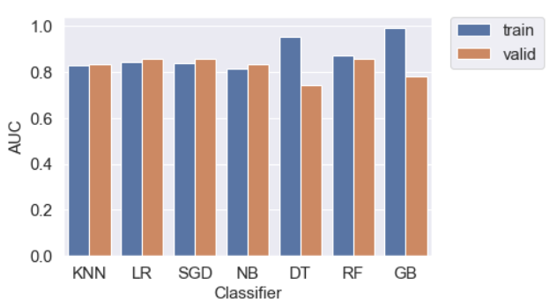
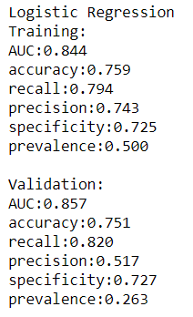
BASELINE MODEL PERFORMANCE
AUC is the area under the ROC curve
Logistic regression is the best fitting model with AUC of 85.8% for validation data.

Slide 6
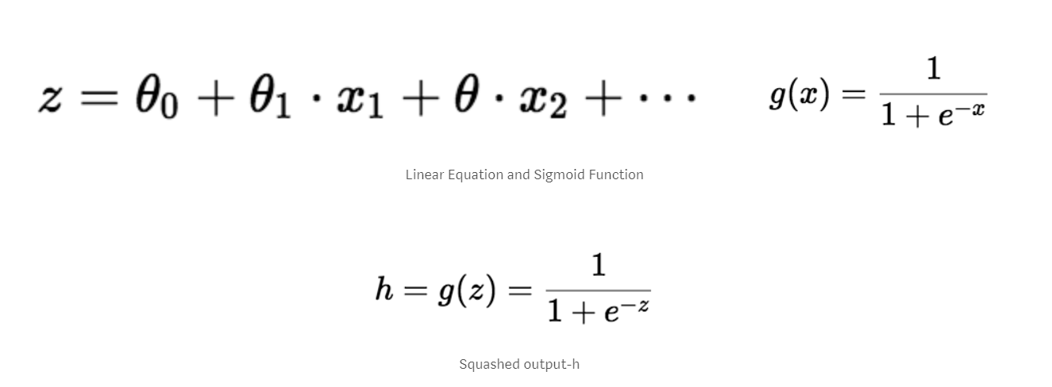
LOGISTIC REGRESSION
Logistic Regression is similar to liner regression
It predicts True or False, it can be used for classification
Fits an S shaped logistic function, the curve goes from 0 to 1
It uses independent variables to predict dependent variable through linear equations. This value lies between negative to positive infinity.
The output of Linear equation is converted into 0(False) or 1(True) using Sigmoid Function

Slide 7
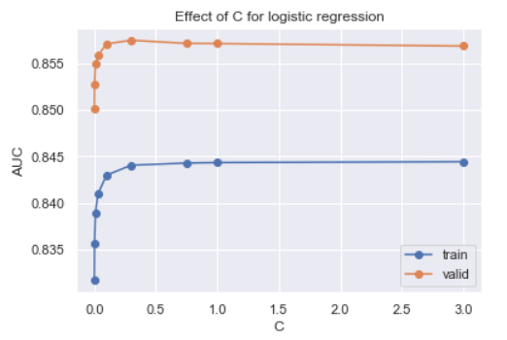
HYPERPARAMETER
They are the parameters which define the model architecture
The process of searching for the ideal model architecture is called hyperparameter tuning
The parameter C is the regularization parameter for Logistic regression, this is the Inverse of regularization strength.
Smaller values of this parameter specify stronger regularization.

Slide 8
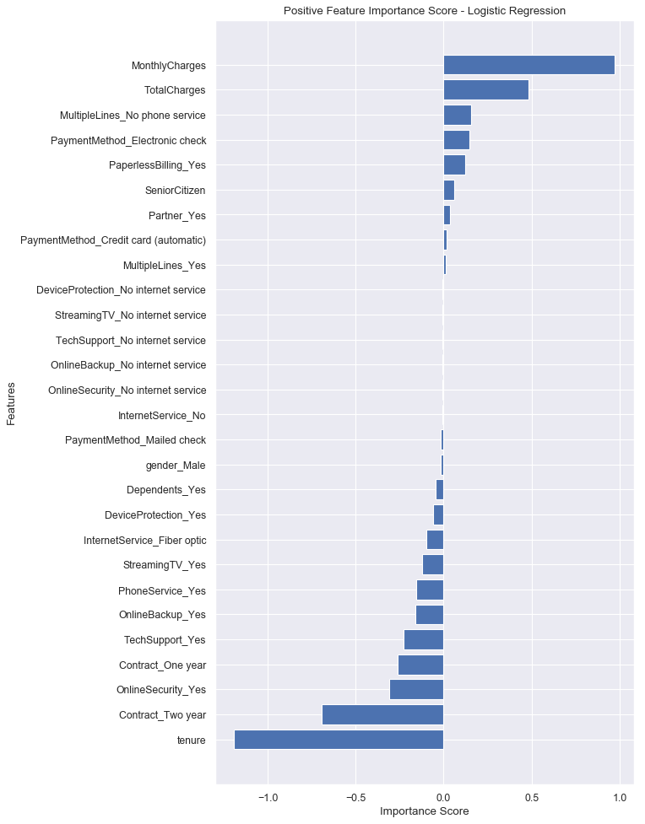
FEATURE IMPORTANCE
As the name suggest, feature importance is how important a feature/variable in a model
When logit value is positive, it increases the probability of the event when the independent variable has a positive change
When logit value is negative, it increases the probability of the event when the independent variable has a negative change
No internet service variables do not affect the model so these features can be neglected
Monthly Charges followed by Total Charges have positive impact, whereas Tenure followed by Contact for 2 years has the highest negative impact

Slide 9
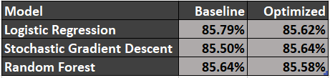
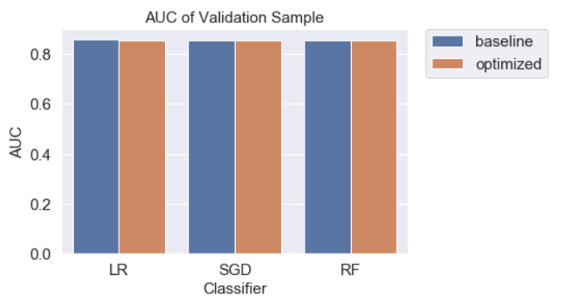
OPTIMIZED MODEL PERFORMANCE
The top three models with high AUC are Logistic Regression, Stochastic Gradient Descent and Random Forest
GridSearchCV and RandomizedSearchCV are used to tune hyperparameters
The baseline model of Logistic Regression has the best AUC.

Slide 10
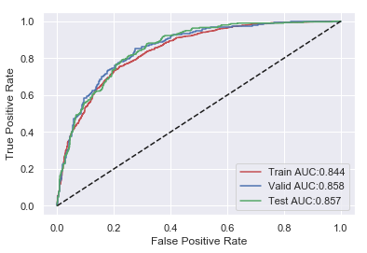
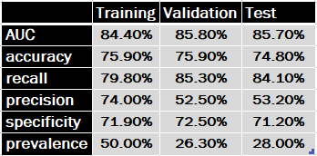
Model evaluation
Baseline Logistic Regression

Slide 11

Thank you

